Slide 1
COMP1003 – Algorithms, Data Structures and Maths Lecture 20 Binary SearchTrees
Thomas Wennekers
University of Plymouth

Slide 2
Main Ideas
Many real-world things are “hierarchical” – they consist of parts that consists of parts that ....
This can well be represented by a data type called “tree”
Trees allow to insert, delete and search for items
Implementations of Trees use pointers / references, but more than just one in linked lists

Slide 3
Why is this important ?
Trees have numerous applications:
Hierarchical Data
File-systems
Game trees / decision trees
Syntax trees, parsing, language processing
Sorting and searching
Some tree implementations implement insert/delete/search in O(log N)

Slide 4
Aims and Objectives
Gain an overview where trees are useful
Learn to implement binary search trees
Estimate the run-time complexity of tree algorithms

Slide 5
Outline
Some application areas of trees
Tree representations on computers
Binary Search Trees
Fundamental Tree operations
Complexity Issues

Slide 6
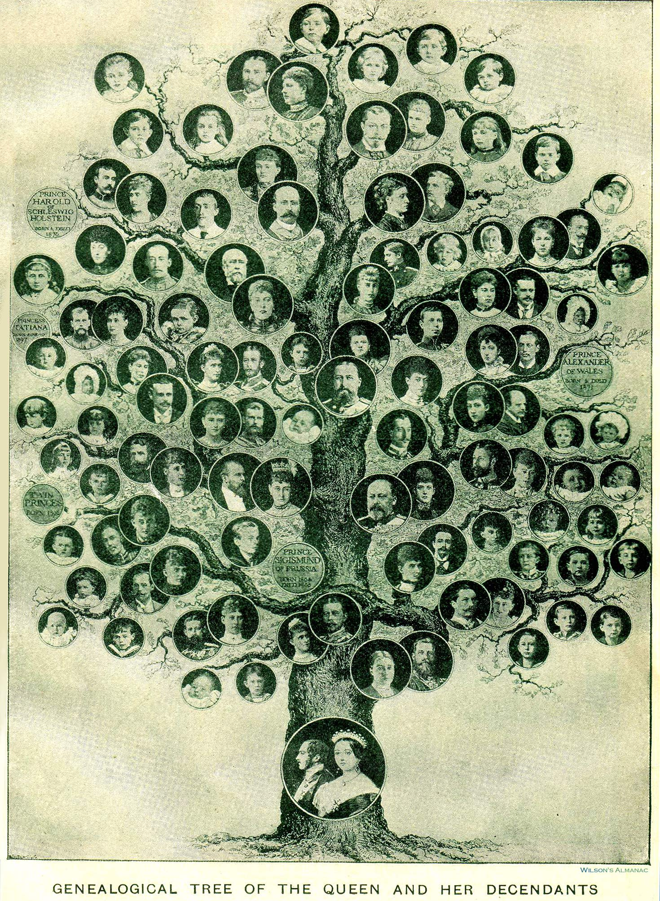
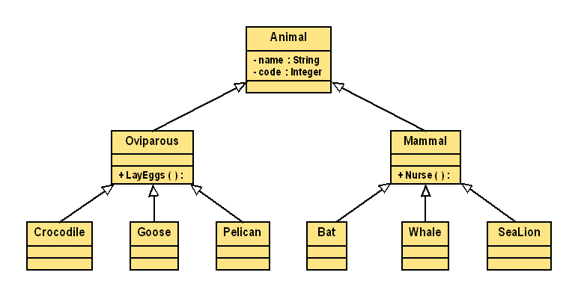
Hierarchical Data

Slide 7
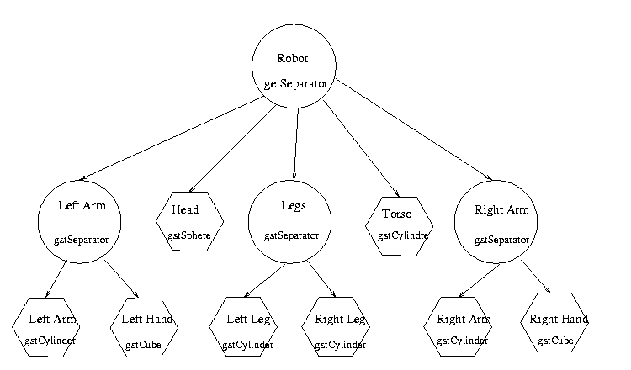
Hierarchical Object Data

Slide 8
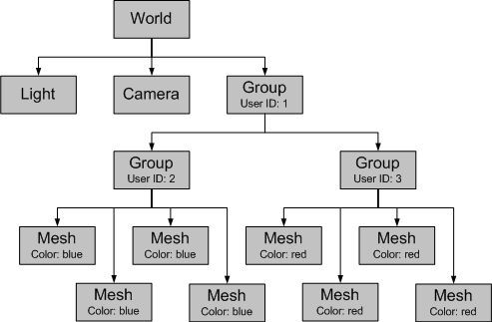
Scene-Graphs (in 3D Graphics)

Slide 9
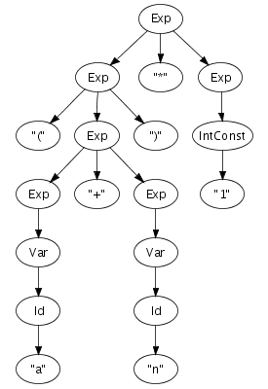
Parse-Trees
( a + n ) * 1
parse-trees represent code
central in compilers and interpreters

Slide 10
Advanced Tree-Based Data Structures
Trees can also be used to implement some advanced data structures efficiently
Dictionaries / Associative Arrays
collections of key-to-data associations
Heaps
a tree where the smallest (largest) element is always the root
Priority Queues
data with “priority” values; often stored as heap

Slide 12
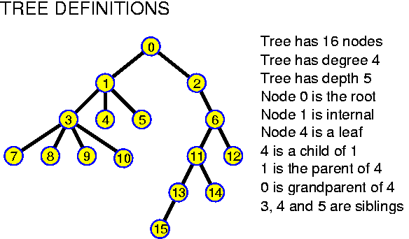
(Some) Tree Definitions

Slide 13
Representations of Trees on Computers

Slide 14
Representation of Trees on Computers
There are many ways for this that can be advantageous in different contexts:
Arrays or lists of Nodes and Edges (pairs of Node indexes that are connected)
Adjacency Matrix
Parent vectors
Pointer implementations

Slide 15
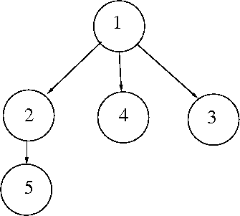
Array Representation
Nodes:
1,2,3,4,5
(can be more
complex types)
Edges:
(1,2), (1,3), (1,4), (2,5)

Slide 16
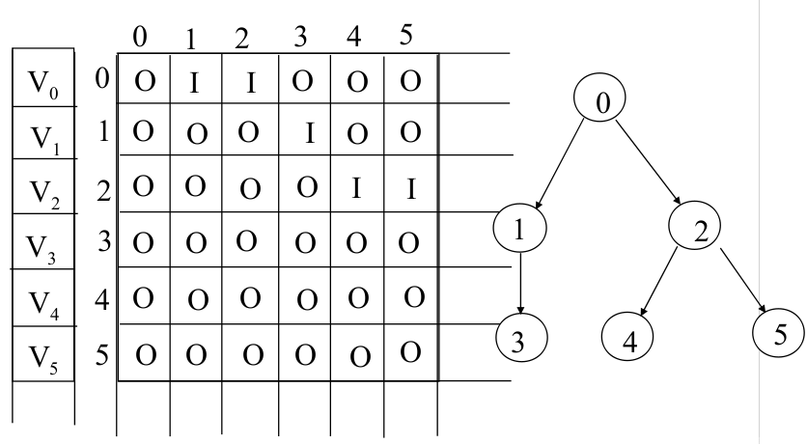
Adjacency Matrix
N^2 space complexity; but easy access

Slide 17
Parent Vector
The root node has no parent; each other node has exactly one parent
It suffices to store the indexes of the parents only in a linear array
This is optimally space efficient
Access from nodes to their children is time-consuming; but not the other direction

Slide 18
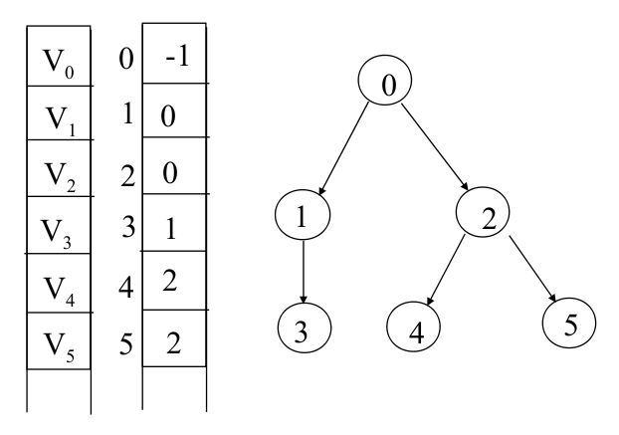
Parent Vector – Example

Slide 19
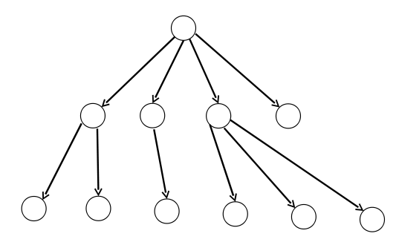
Pointer Implementations
We can use pointers to represent the edges in a tree. Here is a tree:

Slide 20
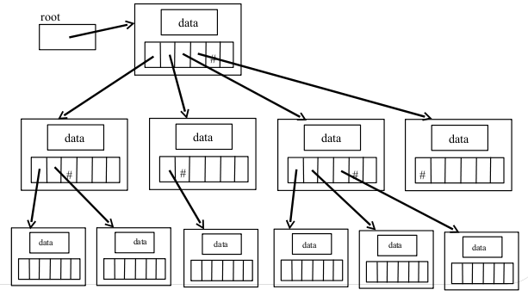
Pointer Implementation using Arrays of Pointers
And here an obvious way to represent the tree using pointers

Slide 21
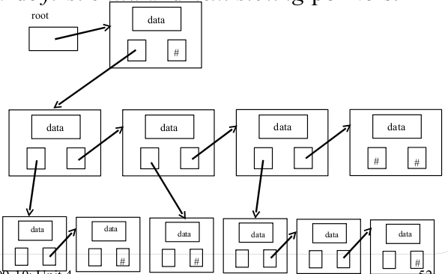
Pointer Implementations using Linked Lists

Slide 22
Binary Search Trees

Slide 23
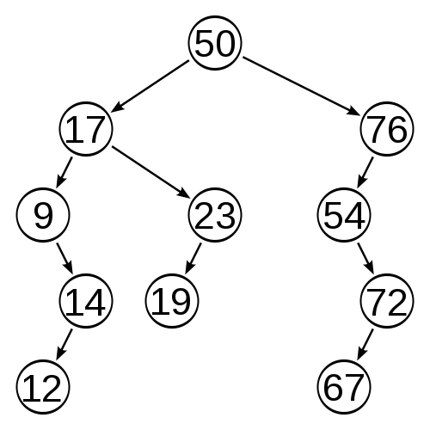
Binary Search Tree
“Binary” = Each node has 0,1, or 2 children
“Search” = The Nodes are ordered:
all nodes in the left sub-tree of a node have keys smaller than the node; all data in the right sub-tree have keys larger than the key

Slide 24
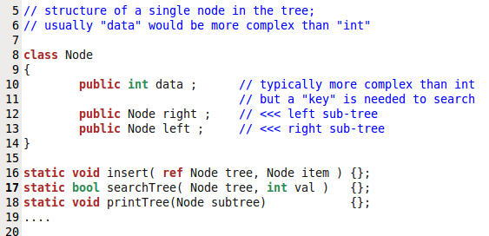
Implementation (start with the interface)

Slide 25
Ordered Insertion
Data items have a search key
The key can be an index, string, or anything else that can be linearly ordered and compared
Insertion works recursively: To insert a new item start at the root; if the current node is empty insert the item; if it is larger then the new item insert the item into the left sub-tree otherwise into the right sub-tree.

Slide 26
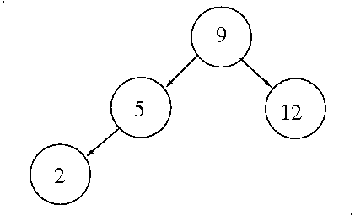
Insertion 1 – Before

Slide 27
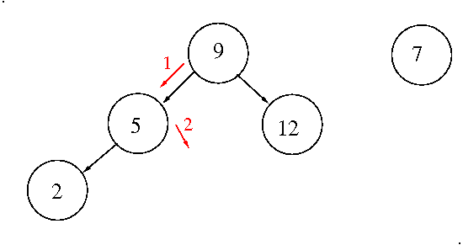
Insertion 2 – New Item

Slide 28
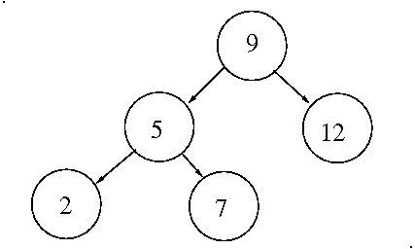
Insertion 3 – After

Slide 29
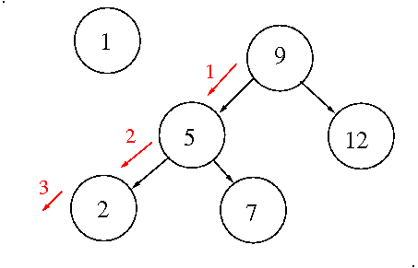
Insertion 4 – Another Item

Slide 30
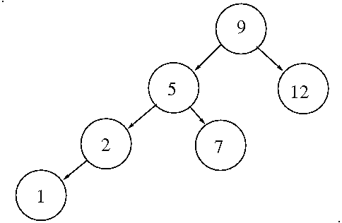
Insertion 5 – Final

Slide 31
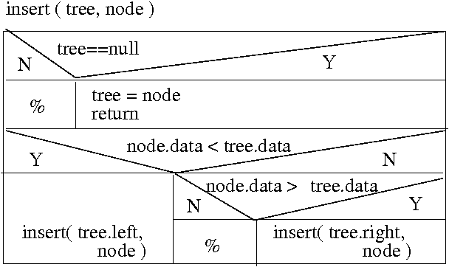
(Ordered) Insertion
Note: if (node.data==tree.data) new node is discarded

Slide 32
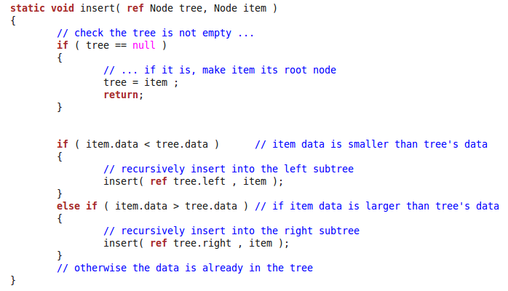
Insertion – Code (recursive!)

Slide 33
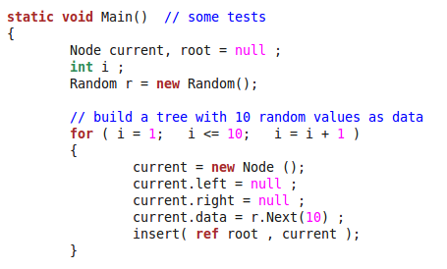
Note the ref-keyword
We need to provide the address/reference of the nodes to be able to re-assign them.

Slide 34
How to implement searchTree ?

Slide 35
Search for 23
<
Start at the root (50)
23 is smaller than 50, so we go left (<);
23 is larger than 17, so we go right (>);
Then we find 23
>

Slide 36
Search for 12
12 < 50 → left
12 < 17 → left
12 > 9 → right
12 < 14 → left
12==12 → found
<
<
>
<

Slide 37
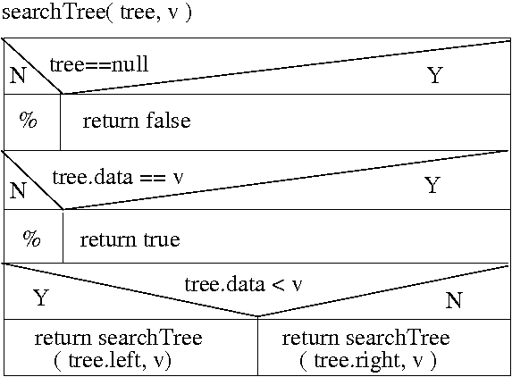
Searching for a Key in a Binary Search Tree
Algorithm builds up a path down the tree
Exit Tests
Traversal

Slide 38
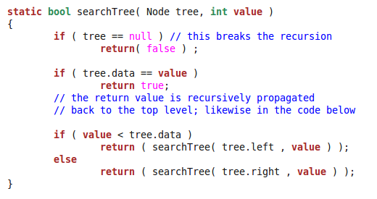
SearchTree Function

Slide 39
How to implement printTree ?

Slide 40
Tree Traversal
Go through the whole tree and print the elements
Two common alternatives:
Depth first traversal
follow children as deep as it gets, then backtrack
Breadth first traversal
process items level by level

Slide 41
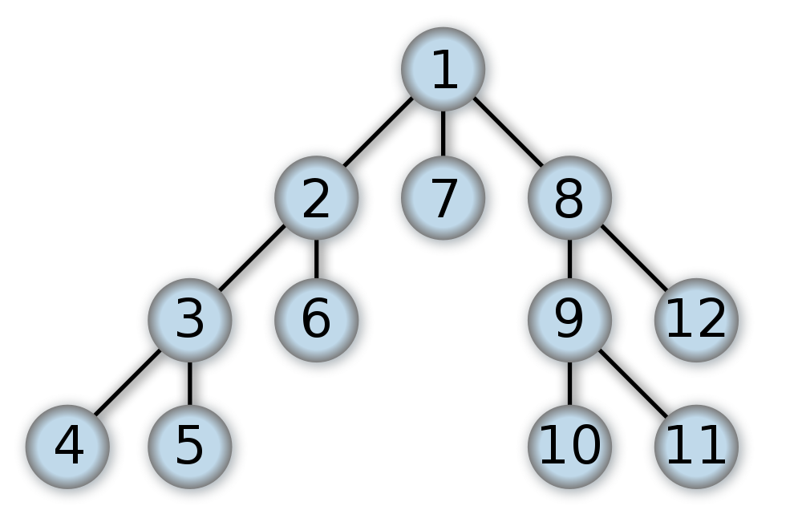
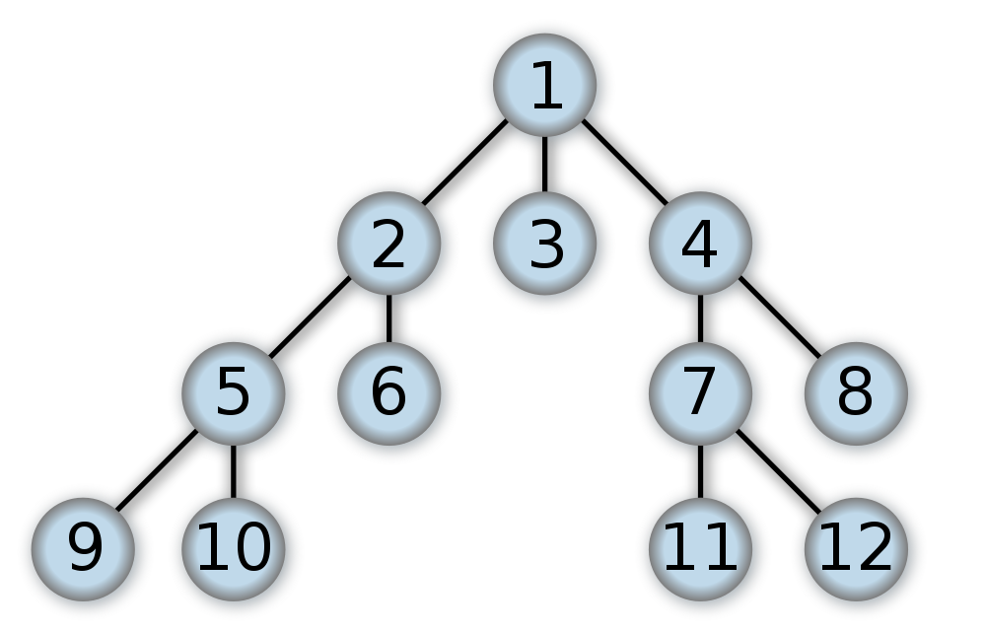
Depth First vs. Breadth First Traversal
Depth-first Traversal Breadth-First Traversal
(see appendix for algorithm)
In depth-first traversal one goes as deeply as possible before back-tracking; breadth-first traversal nodes are visited per level
Note: the numbers indicate the order of traversal, not the keys of the nodes

Slide 42
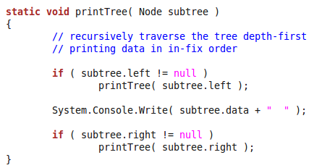
Depth-First Traversal: Recursive Print First process the left sub-tree, then the node, then the right sub-tree
infix-order = data is processed between sub-trees

Slide 43
Infix Traversal Example
infix on a binary search tree proceeds “in order”:
9, 12, 14, 17, 19, 23, 50, 54, 67, 72, 76

Slide 44
This completes our small Implementation of an Ordered Binary Tree
Other operations: deleteNode, Size, Depth, ....

Slide 45
Pre-fix and Post-fix Traversal

Slide 46
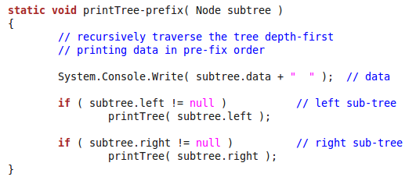
Pre-Fix Traversal
Prefix traversal makes most sense for searching; if an item is found the search should terminate

Slide 47
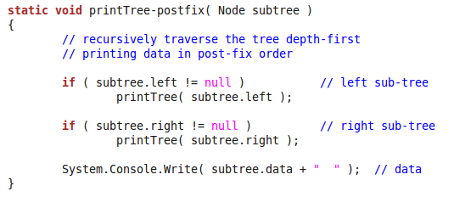
Post-Fix Traversal
Post-fix traversal is useful in syntax parsing and used in some programming languages (e.g., Forth, PostScript) or some pocket calculators

Slide 48
Pre-/In-/Post-Fix Traversal
Prefix printing prints node “50” first
Infix traversal first prints the whole left sub-tree, then 50, then the right sub-tree
Postfix traversal prints “50” last

Slide 49
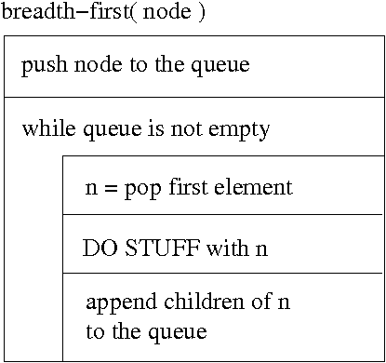
Breadth First Traversal (uses an auxiliary queue for computations)
(Note that the tree in this example is not binary)

Slide 50
Complexity of Binary Search Tree Operations

Slide 51
Complexity of Searching in Binary Trees
The number of available nodes can double between two levels
Binary search is
O(log N) on average

Slide 52
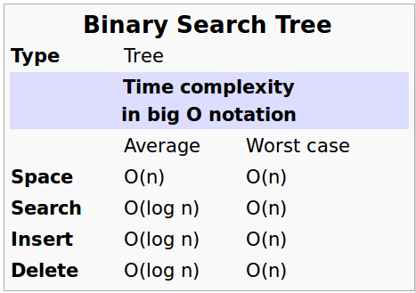
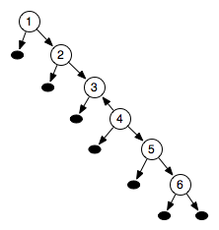
Complexity of Bin-Tree Operations
O(log N) time is used to find an entry; insertion and deletion are O(1); degenerate trees increase the worst case complexity; N item need O(N) space complexity

Slide 53
Outcomes
Concept of trees
Idea that trees have numerous applications
Implementation of binary search trees
Depth and breadth-first traversal
Pre-fix, in-fix- and post-fix traversal
Complexity issues related to tree operations

